Slide 1
STACK
DSA
Presented By : Salim Shrestha

Slide 2
Outline
2.1 Basic Concept of Stack
2.2 Stack as ADT
2.3 Stack Operations
2.4 Infix to Postfix Conversion
2.5 Evaluation of Postfix and Prefix Expressions

Slide 3
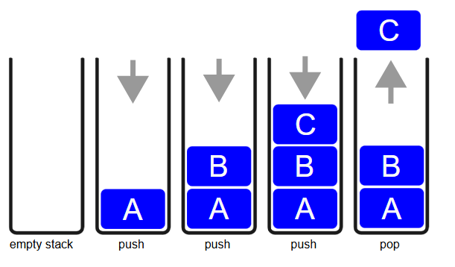
Basic Concept of Stack
• Linear data structure
• Follows LIFO (Last In First Out)
• Real-life analogy: Stack of plates
• Push = add item; Pop = remove item

Slide 4
Stack as Abstract Data Type (ADT)
• ADT: Defines what a data structure does, not how
• Stack ADT supports:
- push(element)
- pop()
- peek()
- isEmpty()
• No concern with internal implementation

Slide 5
Stack Operations
• Push: Insert element on top
• Pop: Remove element from top
• Peek: View top element
• isEmpty: Check if stack is empty
• isFull (optional for fixed-size): Check if full

Slide 6
Infix to Postfix Conversion
• Infix: A + B
• Postfix: A B +
• Algorithm:
- Use stack for operators
- Output operands as they appear
- Pop stack on encountering ')' or lower precedence
• Example: A + B * C → A B C * +

Slide 7
Evaluation of Postfix Expression
• Read from left to right
• Push operands onto stack
• On operator: pop 2 elements, perform operation, push result
• Example:
- Postfix: 23*54*+9-
- Eval: ((2*3)+(5*4))-9 = 17

Slide 8
Evaluation of Prefix Expression
• Read from right to left
• Push operands
• On operator: pop 2 elements, perform operation, push result
• Example:
- Prefix: - + * 2 3 * 5 4 9
- Eval: ((2*3)+(5*4))-9 = 17

Slide 9
Step-by-Step Evaluation Using Stack:
• Example:
- Prefix: - + * 2 3 * 5 4 9
- Eval: ((2*3)+(5*4))-9 = 17
Start reading from right to left:
9 → 4 → 5 → * → 3 → 2 → * → + → -
Push operands until you find an operator:
Push 9
Push 4
Push 5
Operator *: Pop 5 and 4, compute 5*4 = 20, push 20
Push 3
Push 2

Slide 10
Step-by-Step Evaluation Using Stack:
Operator *: Pop 2 and 3, compute 2*3 = 6, push 6
Operator +: Pop 6 and 20, compute 6+20 = 26, push 26
Operator -: Pop 26 and 9, compute 26 - 9 = 17
✅ Final Result: 17
• Example:
- Prefix: - + * 2 3 * 5 4 9
- Eval: ((2*3)+(5*4))-9 = 17V

Slide 11
Conclusion
• Stack is a powerful, simple data structure
• Crucial for expression parsing and recursion
• Understanding stack operations helps in algorithm development

Slide 12
References
• www.geeksforgeeks.org
• www.tutorialspoint.com
• Course textbook materials

